Slide 1
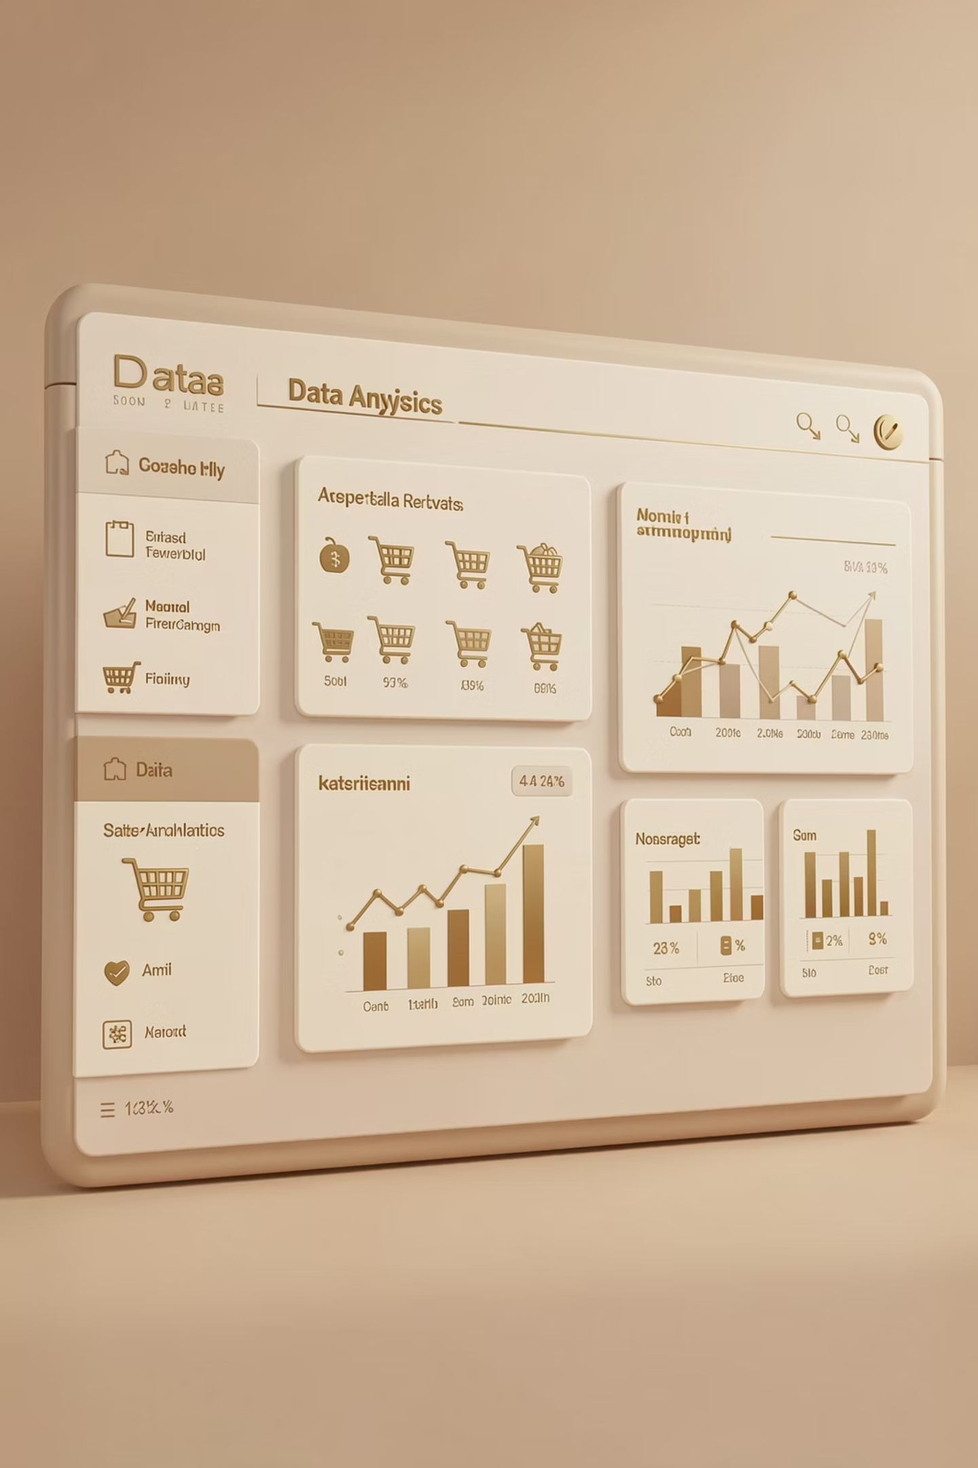
Customer Shopping Behavior Analysis
Uncovering insights from 3,900 purchases to guide strategic decisions

Slide 2
OVERVIEW
Dataset at a Glance
3.9K
18
50
25
Total Purchases
Data Points
Locations
Products
Transactions analyzed
Features per customer
Geographic coverage
Items tracked
Key features: demographics, purchase details, shopping behavior, subscription status

Slide 3
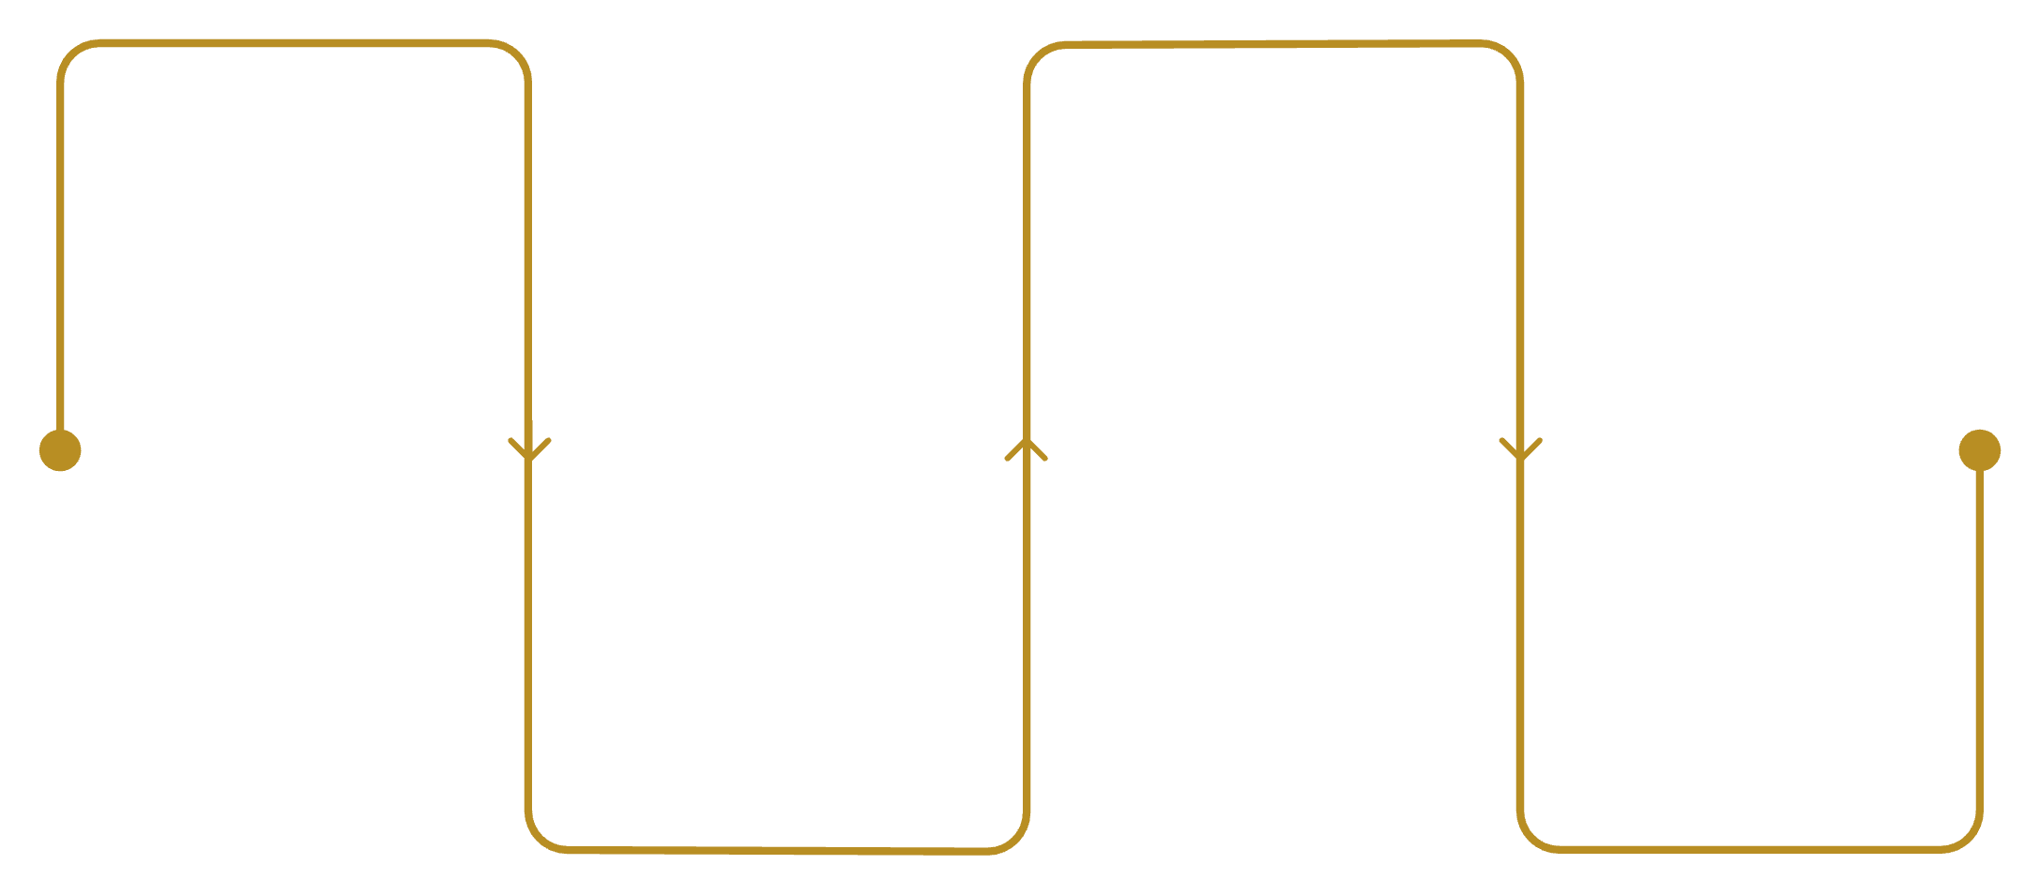
DATA PREPARATION
Python Analysis Pipeline
Key Transformations
Load Data
Engineer Features
Import CSVs and DB tables
Imputed missing review ratings using category medians
Created age groups and purchase frequency metrics
Standardized column names to snake_case
Integrated with PostgreSQL for advanced analysis
Create age groups and metrics
Export to SQL
Clean & Impute
Write cleaned data to PostgreSQL
Fix types and fill missing values

Slide 4


Revenue Insights by Gender
68%
32%
Male Customers
Female Customers
$157,890 total revenue
$75,191 total revenue
Male customers drive twice the revenue despite similar purchase patterns

Slide 5
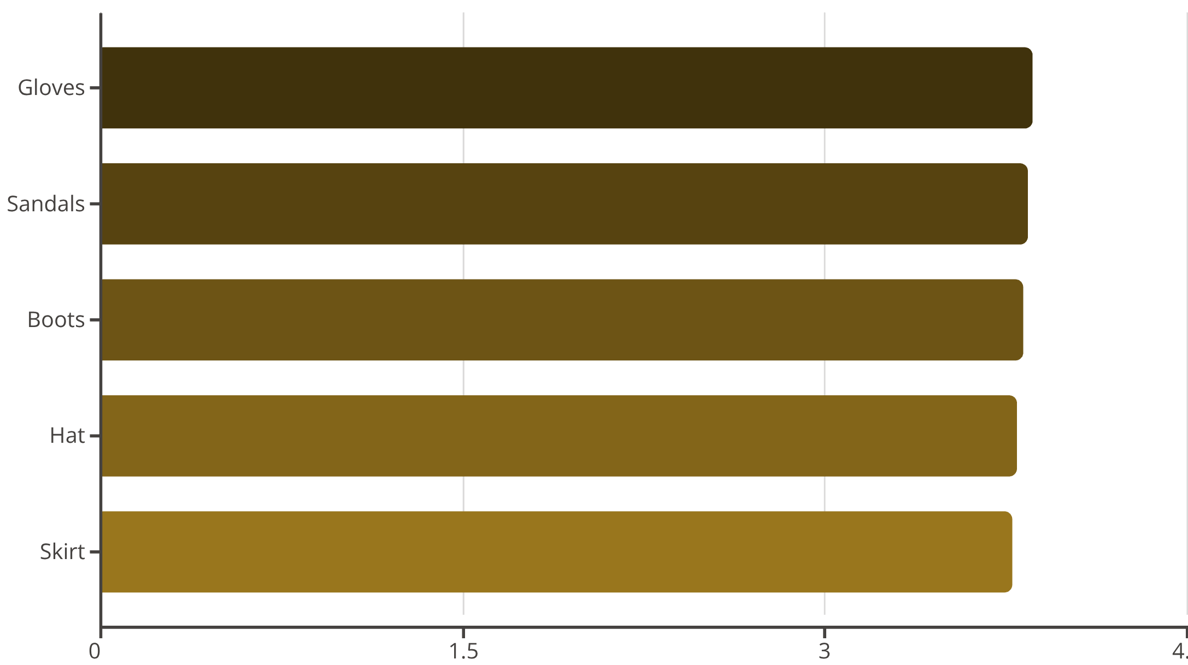
Top Performing Products
Customer Favorites
Accessories and footwear lead in satisfaction ratings
Average rating across all products: 3.75 stars
These top-rated items should be featured prominently in marketing campaigns

Slide 6
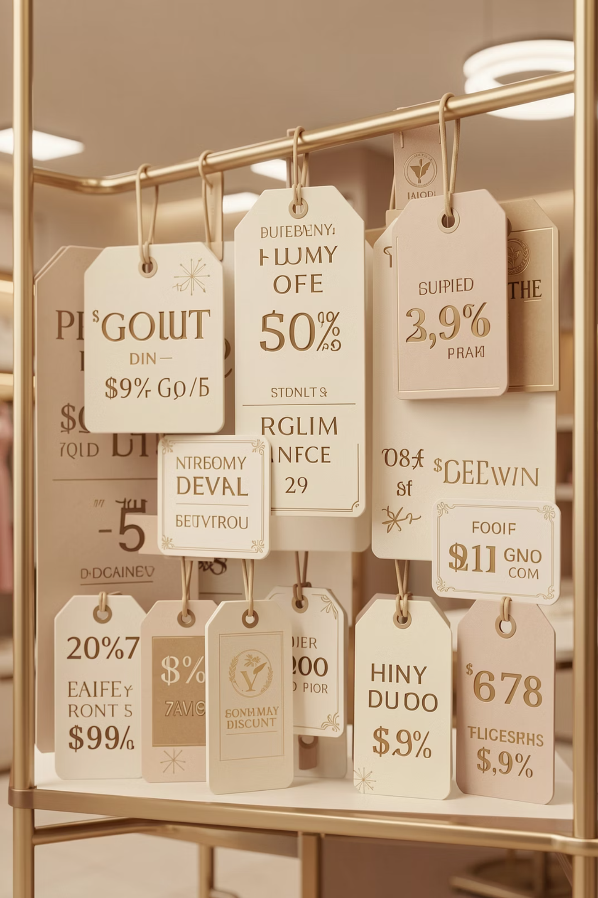

DISCOUNT ANALYSIS
Smart Spenders: High-Value Discount Users
839 Customers
Strategic Buyers
Revenue Impact
Used discounts but spent above average
Maximize value without sacrificing quality
Balance promotions with margin control

Slide 7
Customer Segmentation
Purchase Behavior Segments
Classification based on purchase history reveals loyalty patterns
80%
18%
2%
Loyal
Returning
New
3,116 customers
701 customers
83 customers

Slide 8


SUBSCRIPTION INSIGHTS
Subscription Status Comparison
Subscribers
Non-Subscribers
1,053 customers
2,847 customers
Avg spend: $59.49
Avg spend: $59.87
Revenue: $62,645
Revenue: $170,436
Similar spending patterns suggest untapped subscription growth potential

Slide 9
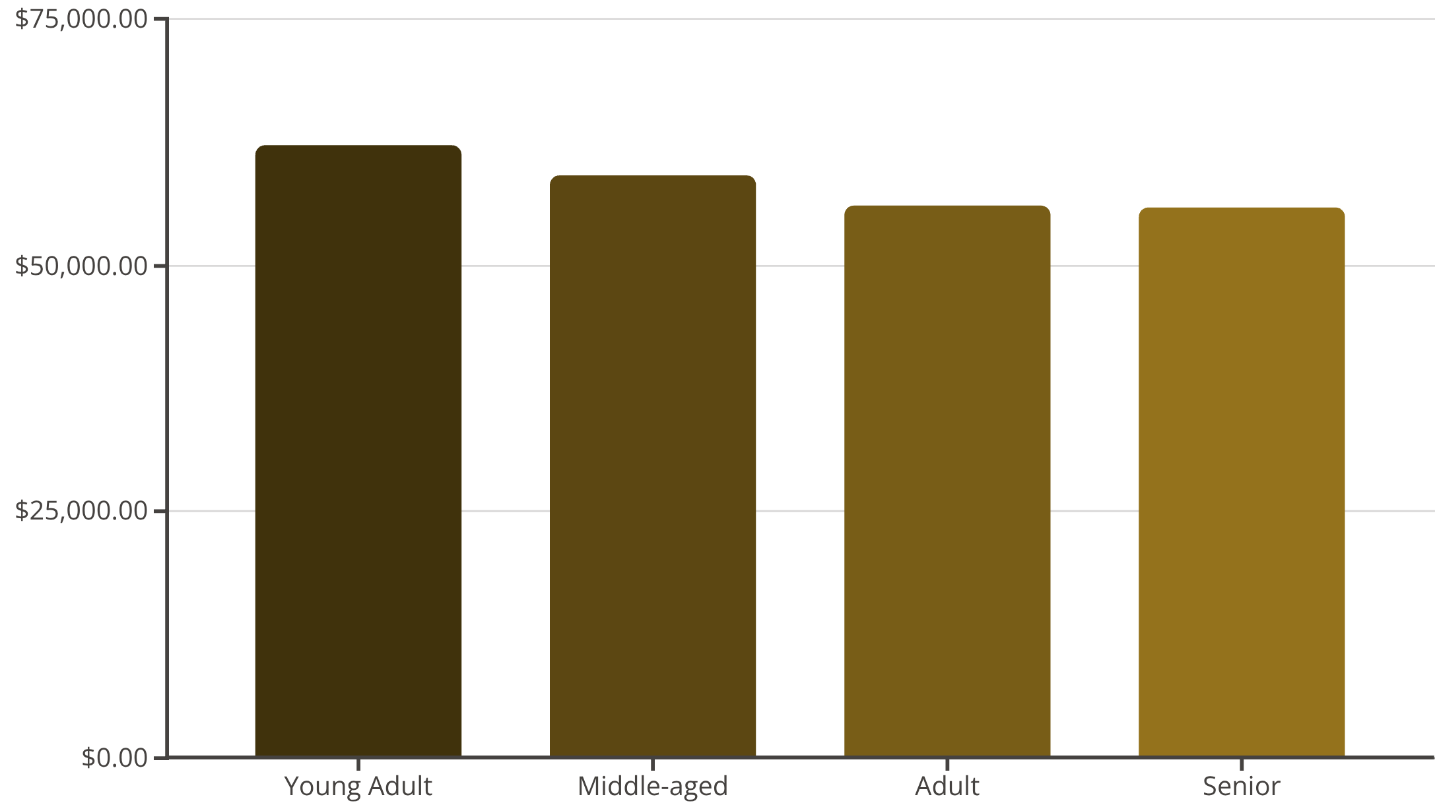
Revenue by Age Group
Demographic Insights
Young adults lead revenue generation with consistent spending across all age groups
Target marketing efforts toward high-value young adult segment while maintaining engagement across demographics

Slide 10
RECOMMENDATIONS
Strategic Action Plan
01
02
03
Boost Subscriptions
Loyalty Programs
Optimize Discounts
Promote exclusive benefits to convert non-subscribers
Reward repeat buyers to increase retention
Balance sales growth with margin control
04
05
Product Positioning
Targeted Marketing
Highlight top-rated items in campaigns
Focus on high-revenue segments and express shipping users

